Slide 1
UK GovernmentData Analytics Project
Project Aim:
Analyse COVID-19 Data
Identifying various trends across Regions
Direct Vaccination Campaign in required Region

Slide 2
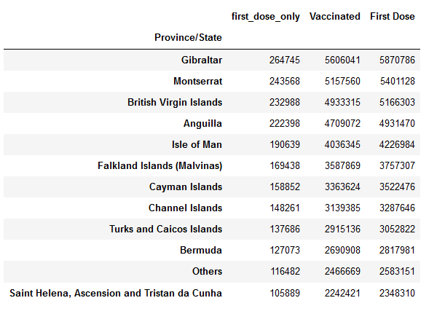
Vaccination Status
COVID-19 Data
Regions with most and least fully vaccinated people
Regions with most and least ‘First Dose Only’ population

Slide 3
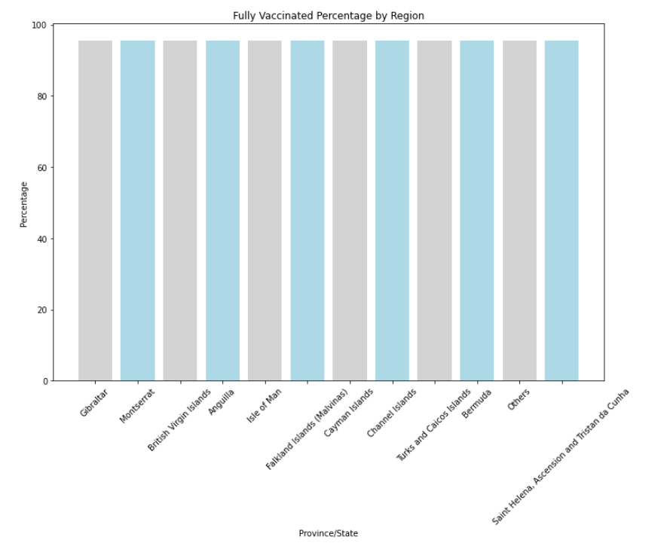
Vaccination Status
All Regions above 95% for fully vaccinated people
Differences seem to have disappeared looking at percentages.

Slide 4
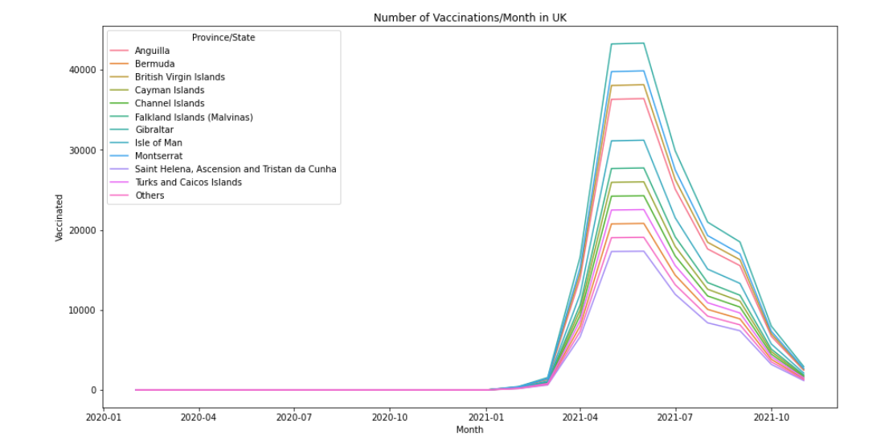
Vaccination Rate
All Regions show a similar trend line.
Difference in size is due to population size.

Slide 5
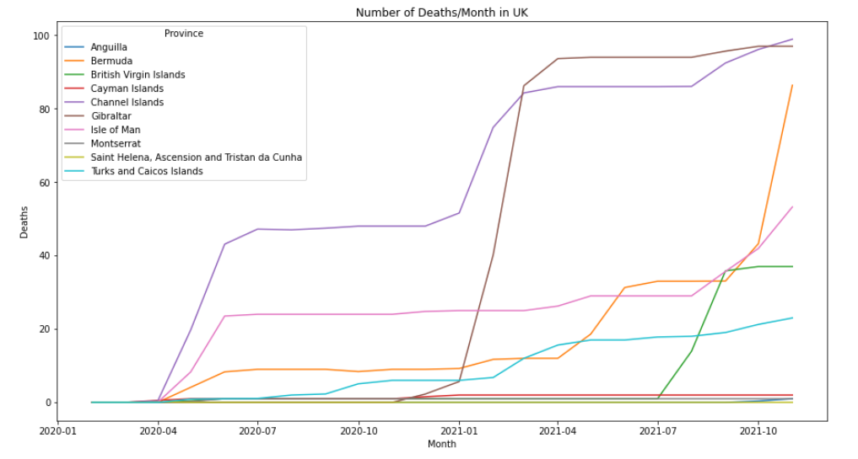
Death Rate
Some Regions have achieved peak
Some are on rising trend
Some of them have been stable throughout

Slide 6
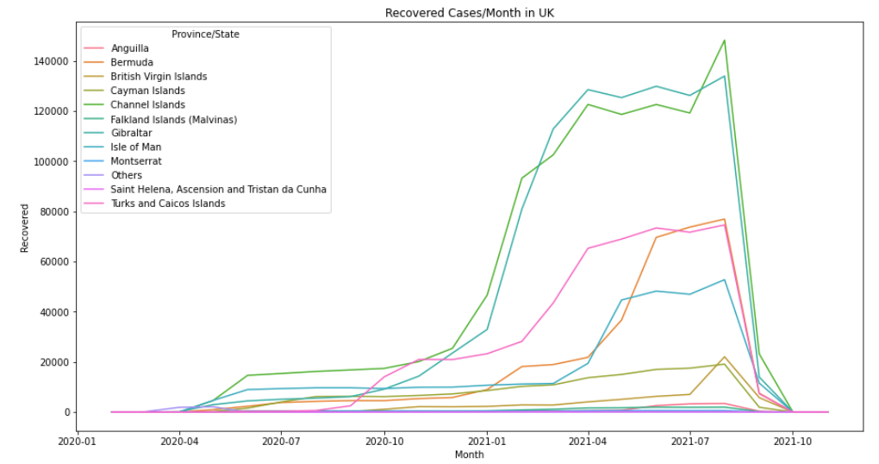
Recovery Rate
Every region show a similar trend
Size difference is due to population size and number of cases.

Slide 7
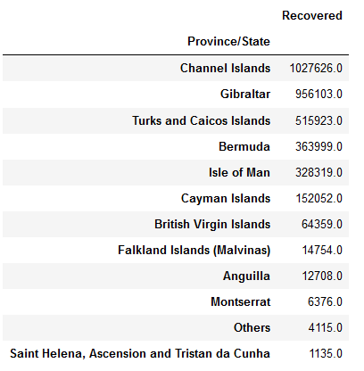
Recovery Status
Total number recovered across various regions

Slide 8
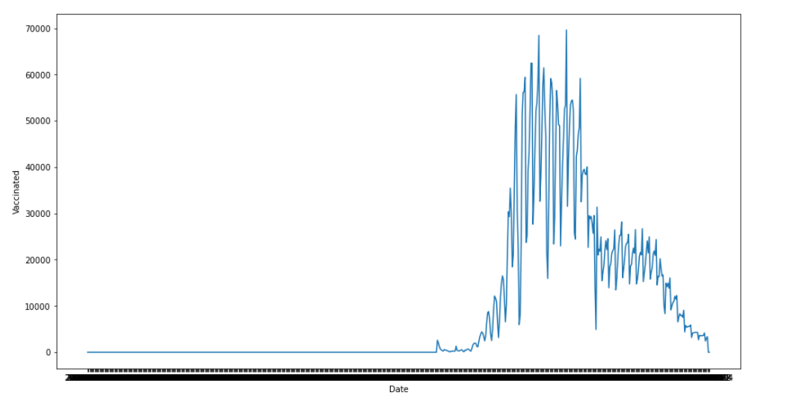
Vaccination Timeline
Gibraltar Analysis
Vaccinations have peaked around April – May 21
Dropped after that as more than 95% are fully vaccinated now.

Slide 9
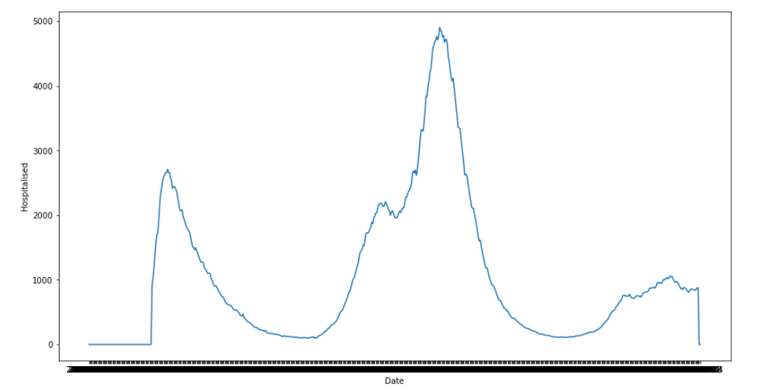
Hospitalisation Timeline
Very similar to Vaccination trend line
Has vaccination resulted in lower hospitalization?

Slide 10
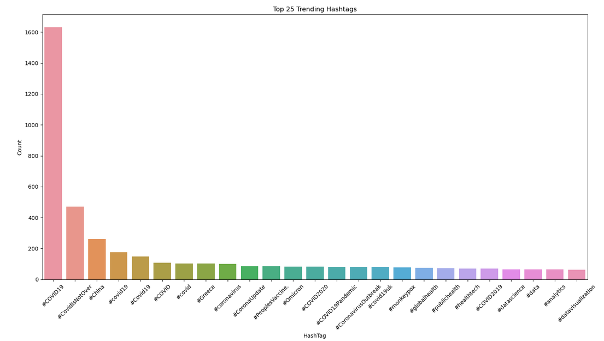
Top 25 Trends
Twitter Trend Analysis
Extracts from a week in May 2022
15 out of 25 relates to COVID-19
Top Trend is #COVID19
Why is it the top trend even in May 2022?

Slide 11
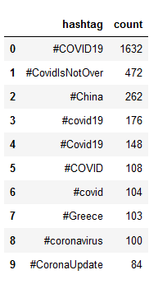
Top Trend Counts
8 out of top 10 are COVID related (not counting China)
Are these dominated by a particular region?

Slide 12
Concerns
Data Irregularities
Hospitalisation cases are more than total cases across regions
Fully Vaccinated people appear on records from the beginning
No record of Recovered people post 04/08/2021
Increase in Death rate in certain regions after achieving 95% vaccination
No Recoveries recorded in ‘Other’ Province/States post 12/04/2021, and High Death skewing the Data.
In Gibraltar, first death case recorded 8 months after first recorded COVID case.

Slide 13
Conclusion
Irregularities in Data causes doubts regarding its accuracy and validity
Can direct campaign towards regions with rising death rate (depending on population size)
Can target regions with higher ‘First Dose Only’
Is there a need for this campaign? (95% fully vaccinated across regions)

Slide 14
QUESTIONS??

